Slide 1

Understanding Spark Architecture and Lifecycle

Slide 2
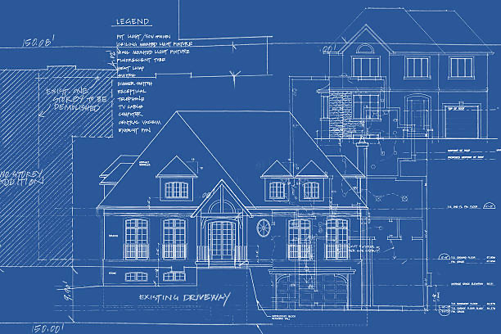
What is Spark Architecture ?
Master/Worker Architecture.
Spark Driver Program
SparkContext
Cluster Manager
Executors
Task
Shuffle
Result
I will go more in depth in the lesson 5

Slide 3

Diagrammatic Overview
Image source: https://spark.apache.org/docs/latest/cluster-overview.html

Slide 4
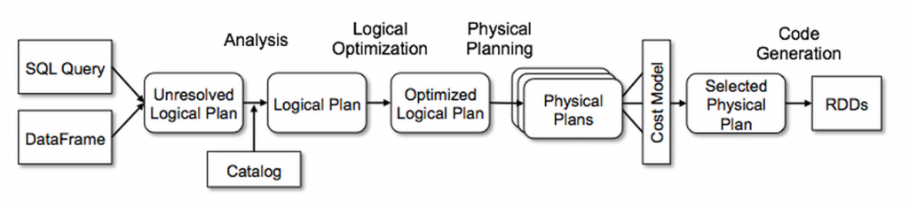
Spark components
Environment Setup
Application and Development
Job Execution
Monitoring and Optimization
Job completion
Maintenance
Image: databricks.com/glossary/catalyst-optimizer
I will go more in depth in lesson 6

Slide 5
Next…

